Slide 1


L&ARN
TEACH TO LEARN
PRESENTED FOR DR. RASHA ELBANNA
By Pakinam,Karim,Ahmed,Sama,Yassmin

Slide 2
OVERVIEW
01
INTRODUCTION
05
USER EXPERIENCE
02
KEY FEATURES
06
FEEDBACK MECHANISMS
03
DESIGN RATIONALE
07
CONCLUSION
04
DEMONSTRATION

Slide 3

What is the problem?
Free online courses sometimes have poor content, so people need better options.
Many skill-based courses come with prohibitive costs, making them inaccessible to a large portion of learners.

Slide 4

Project Idea:
• The system facilitates communication between learners and instructors for scheduling and conducting lessons.
• Users earn points by teaching others content or skills.
• Points can be used to pay for lessons or tutorials from other users.
• An online learning and skill exchange platform.

Slide 5


Target audience:
Teachers
Learners

Slide 6



Color schema:
Teaching mode
text (light mode)
Background (light mode)
text (dark mode)
learning mode
Background (dark mode)
some Icons

Slide 7
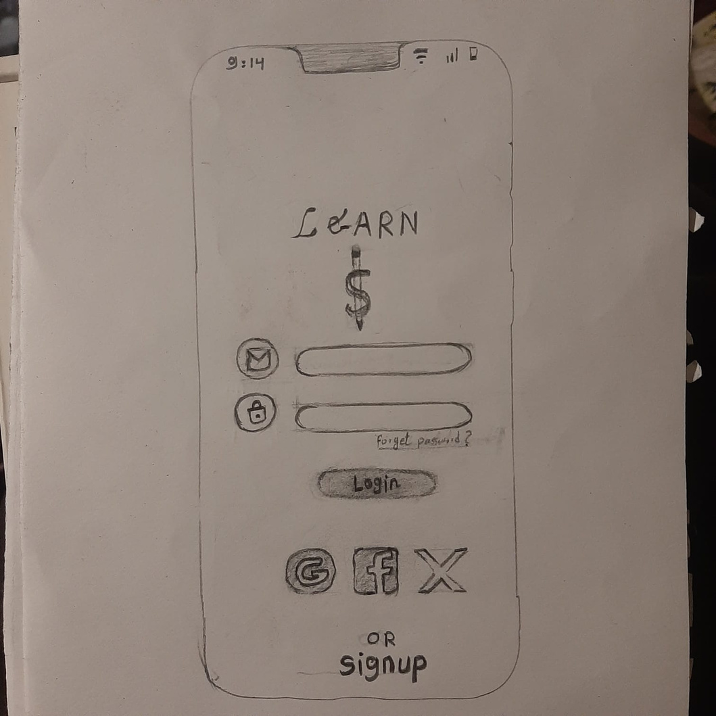
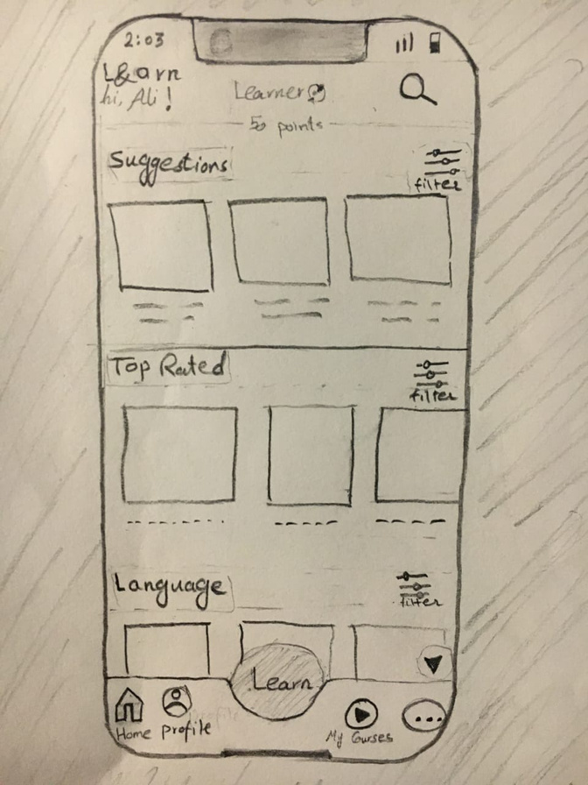
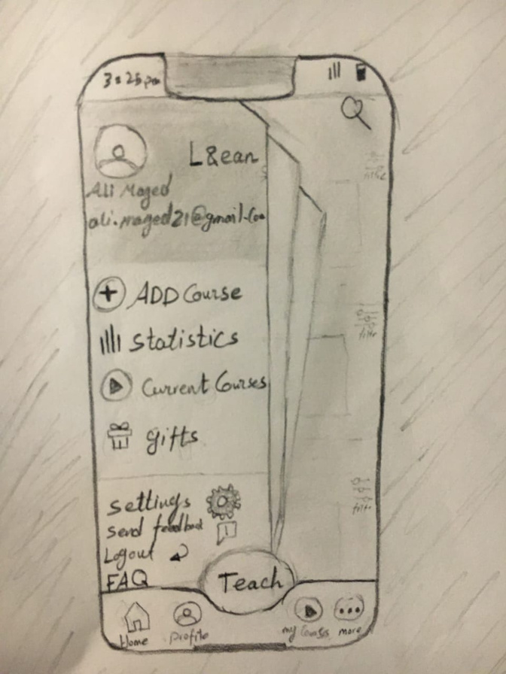
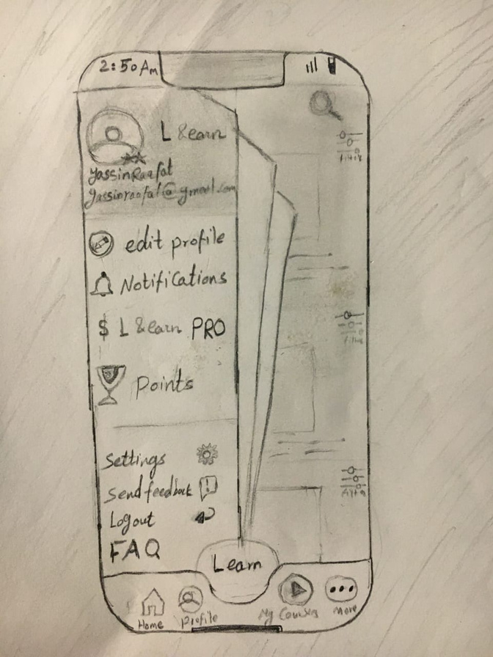
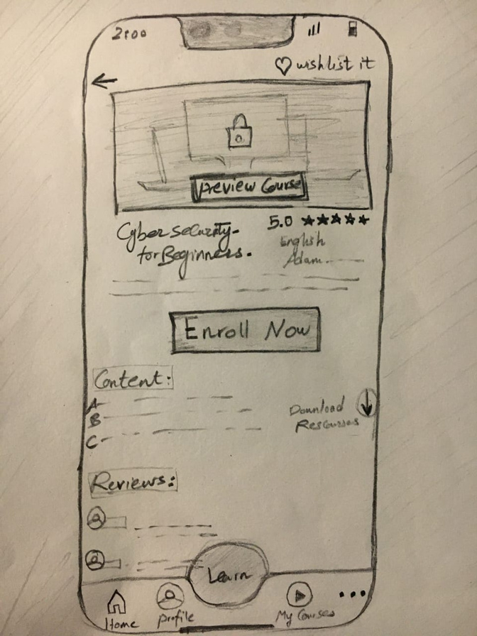
Prototype:

Slide 8
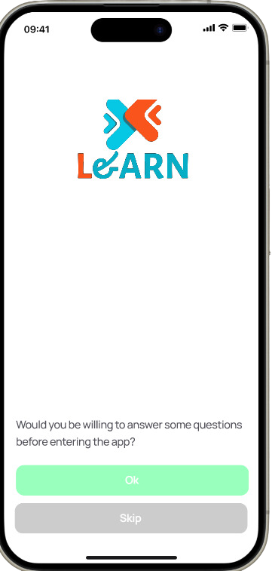
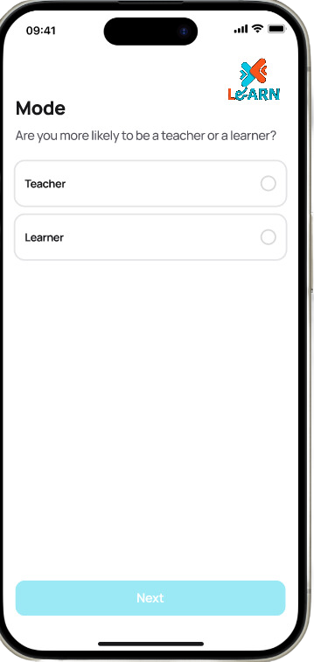
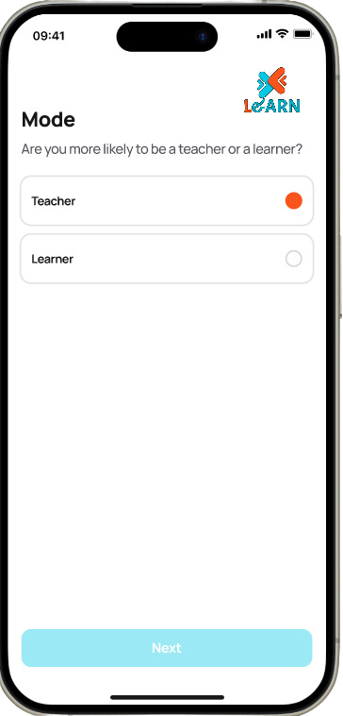
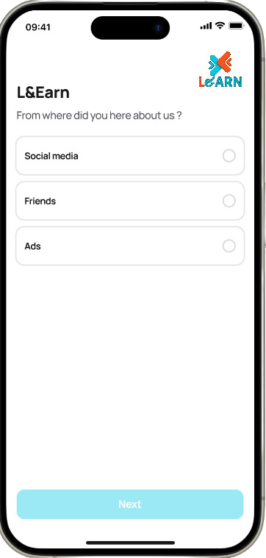
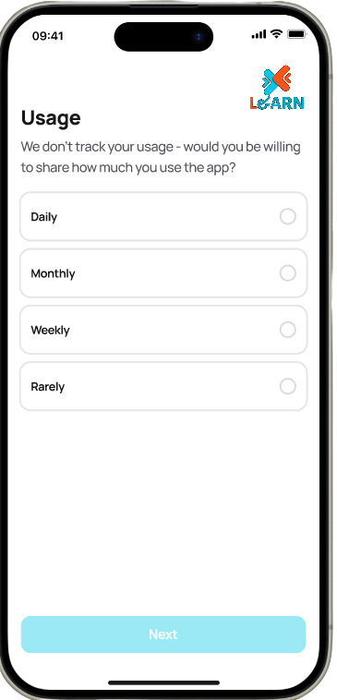
Prototype:

Slide 9
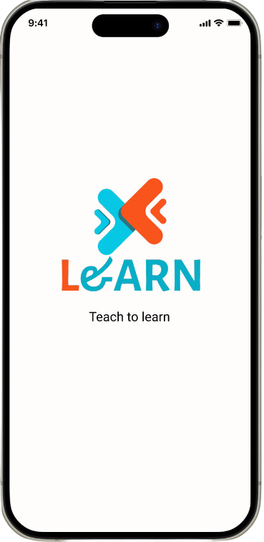
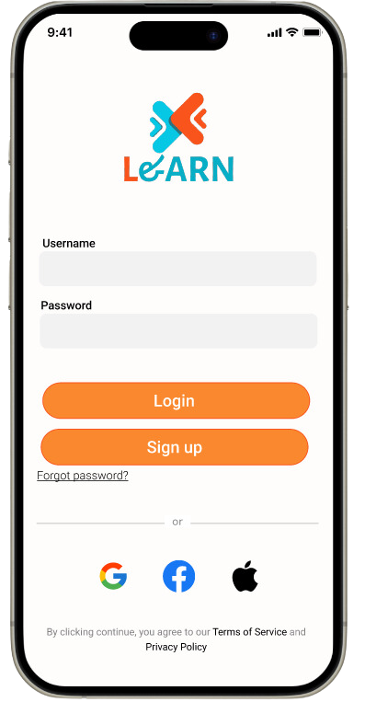
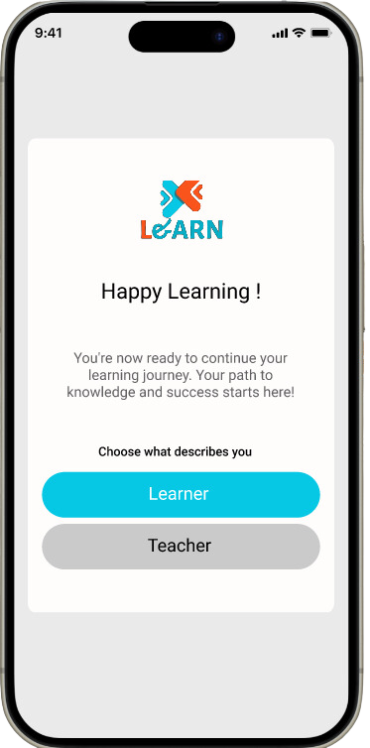
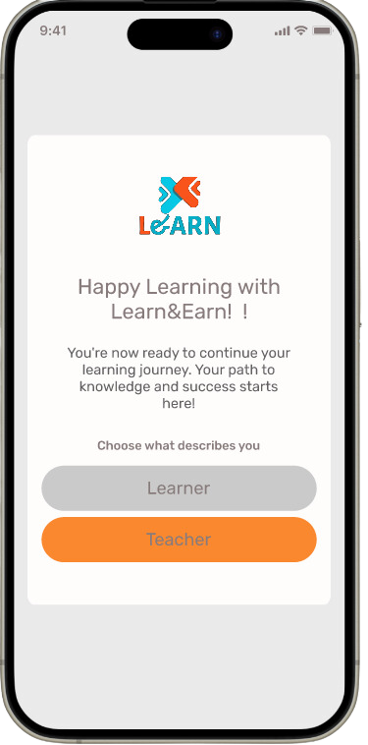
Prototype:

Slide 10
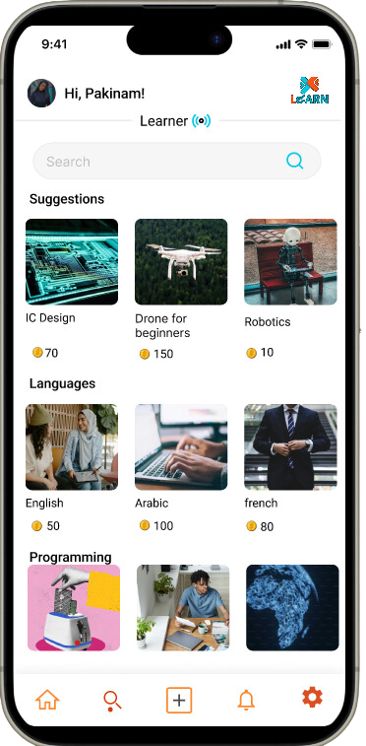
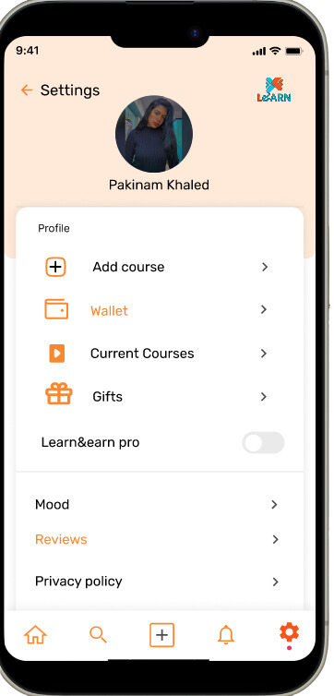
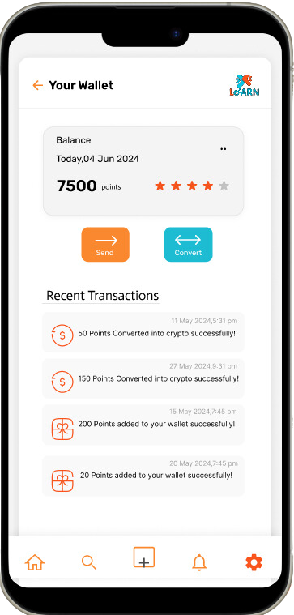
Prototype:

Slide 11
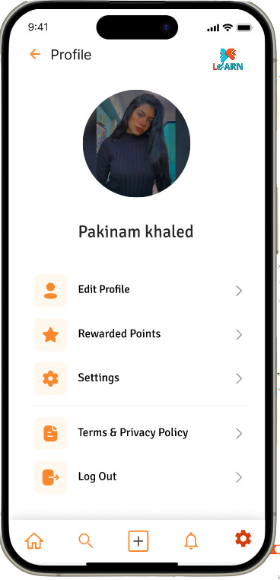
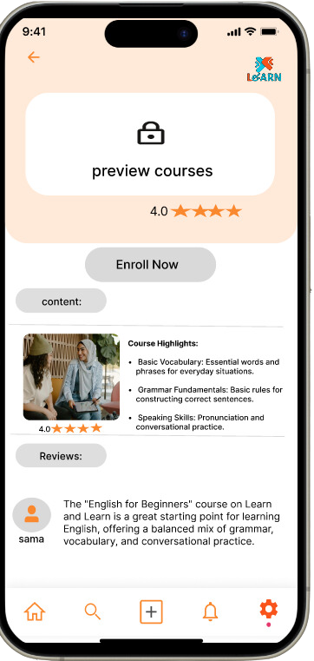
Prototype:

Slide 12
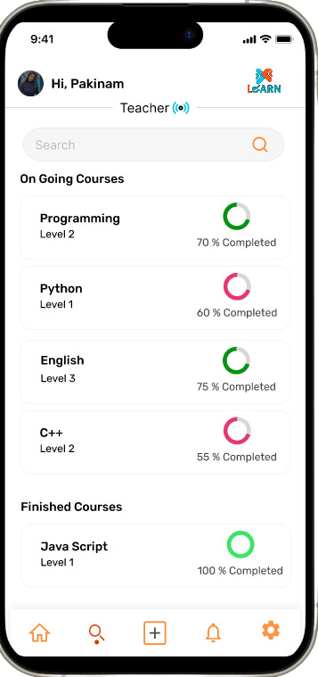
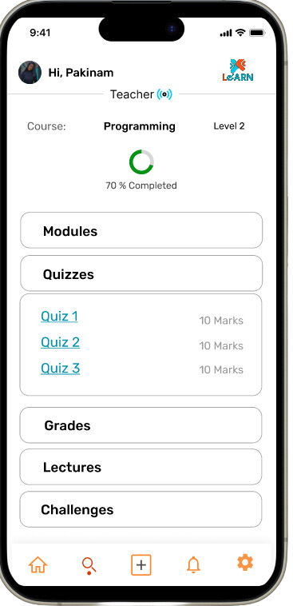
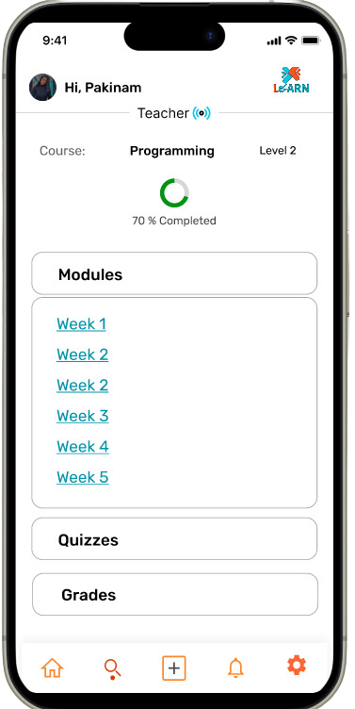
Prototype:

Slide 13
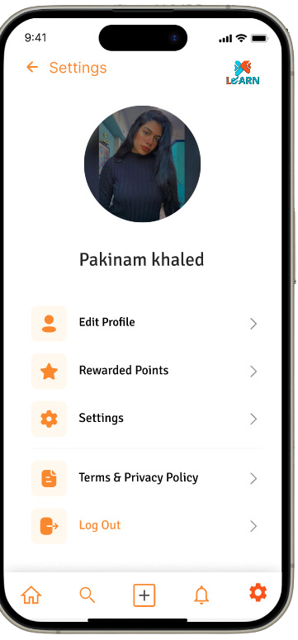
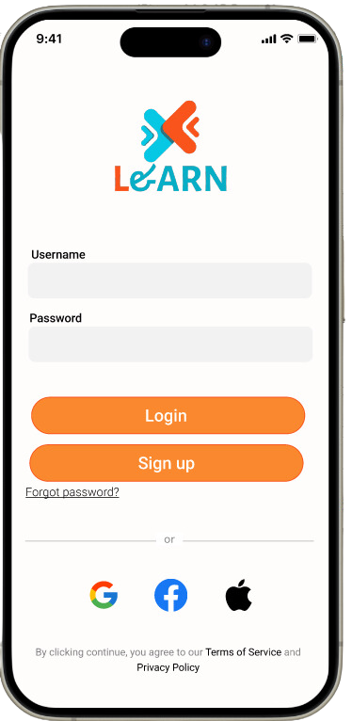
Prototype:

Slide 14
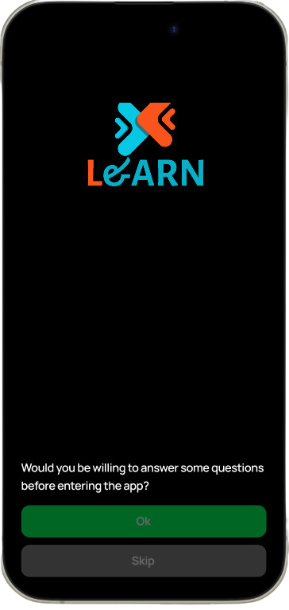
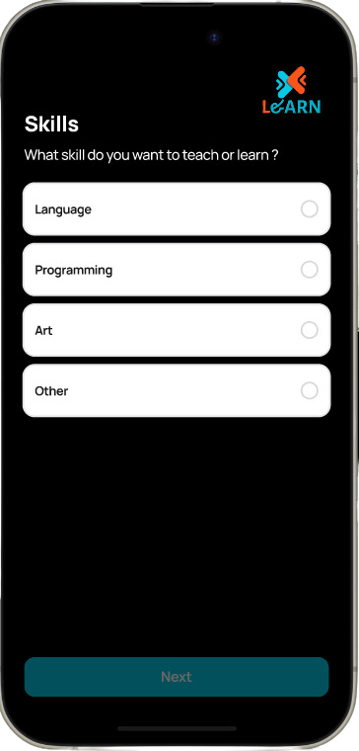
Prototype:

Slide 15
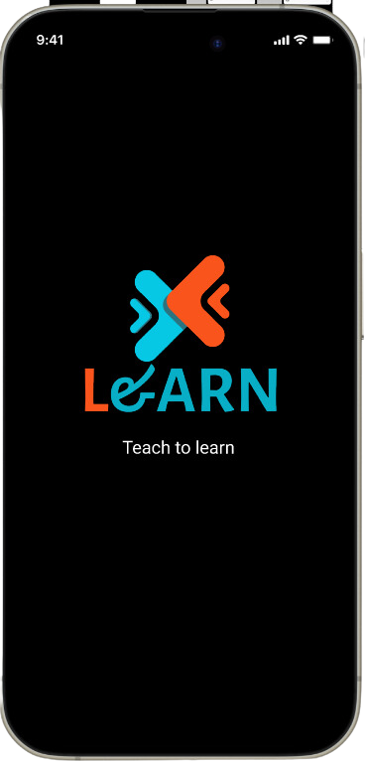
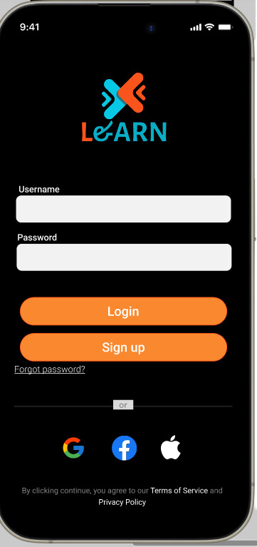
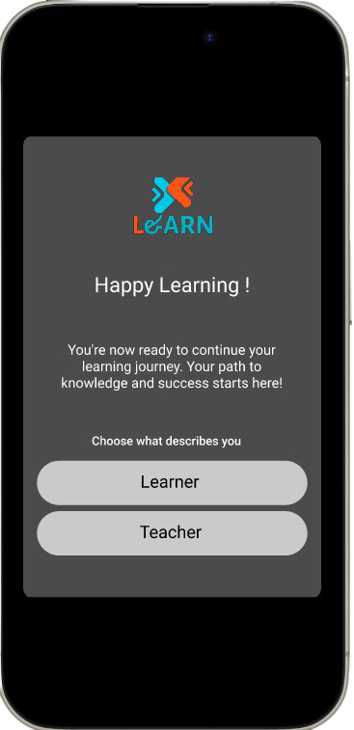
Prototype:

Slide 16
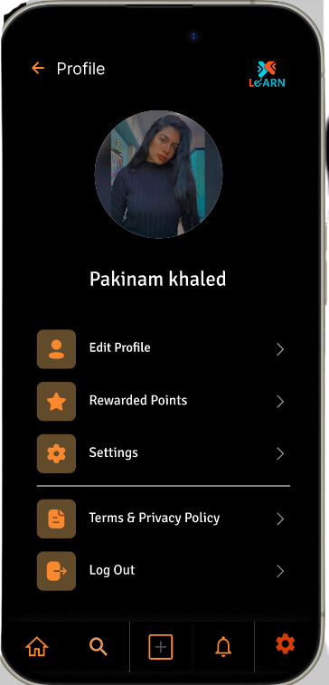
Prototype:

Slide 17
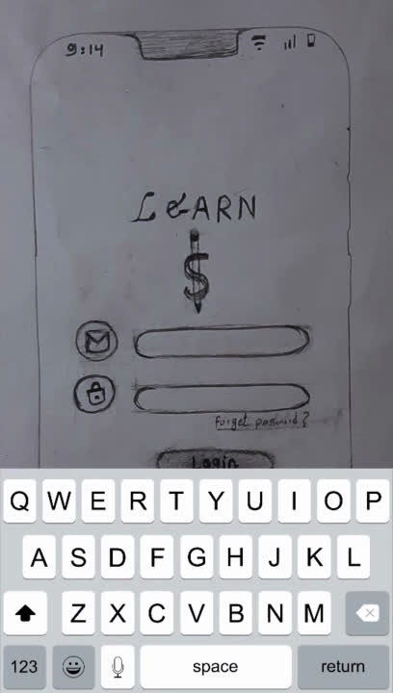

Slide 18
Thank you :)

